Slide 1
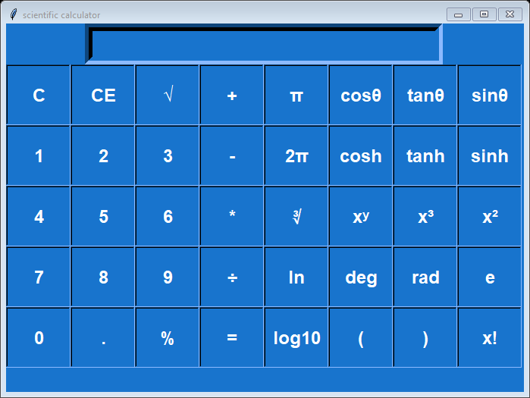
Scientific GUI Calculator Using Tkinter
By Yatendra Singh

Slide 2
Tools which are using to create gui calc
Import tkinter gui module for graphic representation
Import math library
Get function take input
For loop
If else condition

Slide 3
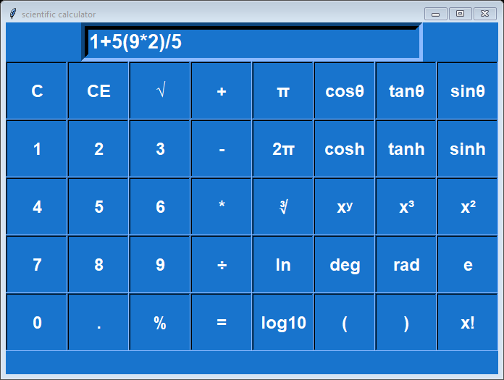
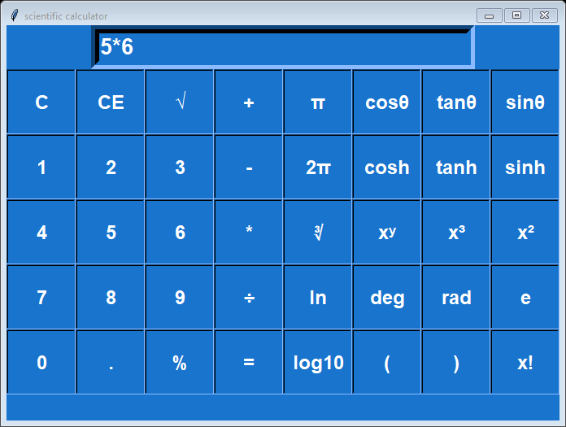
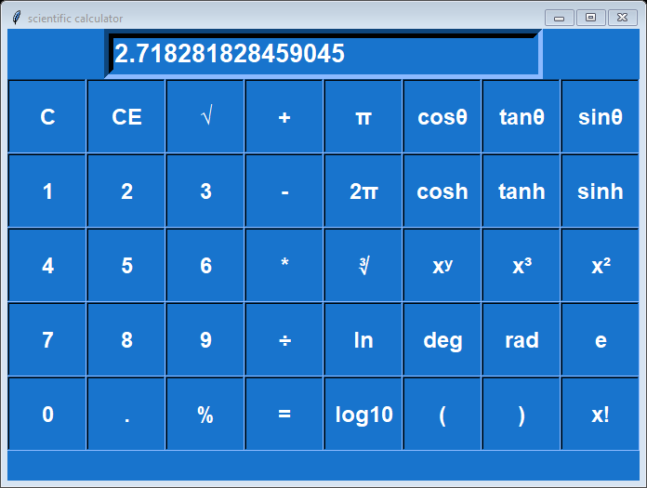
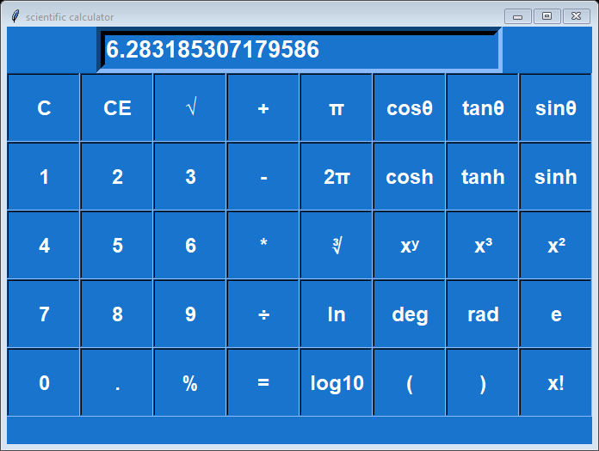
GUI Inter face and Working

Slide 4
Graphical Representation
Create entry field and define geometry
All scientific button list using list method
Use for loop on button
Increase row value by pluse equal to show all buttons

Slide 5
Operation on button
Define Click function
Use get method to take value in the enteryfiled
Use delete function to delete the enteryfiled value
Use math function for scientific calculation
Use eval function to evaluate the mathematical operation
Delete function to delete the value from entry field
Insert function to insert the value in answer variable
Grid method to pack the button and entry value

Slide 6
Conclusion
Using all operation on button, I am getting success to create a pretty interface of calculator that all operation working fine.

